Slide 1
StarGAN
Pattern Recognition & Machine Learning Laboratory
Tae-jin Woo
Aug 17, 2021

Slide 2
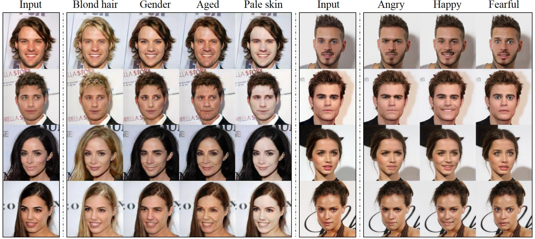
StarGAN: Unified Generative Adversarial Networks for Multi-Domain Image-to-Image Translation [Y. Choi et al., 2018] (1/7)
Goal
Solving scalability and robustness in handling more than two domains
Motivation
Improving network efficiency in multi-domain image-to-image translation
Learning general features in multi-domain image-to-image translation
Contribution
Proposing a single network for multi-domain image-to-image translation
Proposing joint training method on multi-dataset
Achieving State-of-the-Art (SOTA) in image-to-image translation
Multi-domain image-to-image translation results
Y. Choi et al., “StarGAN: Unified Generative Adversarial Networks for Multi-Domain
Image-to-Image Translation,” Computer Vision & Pattern Recognition, 2018.

Slide 3
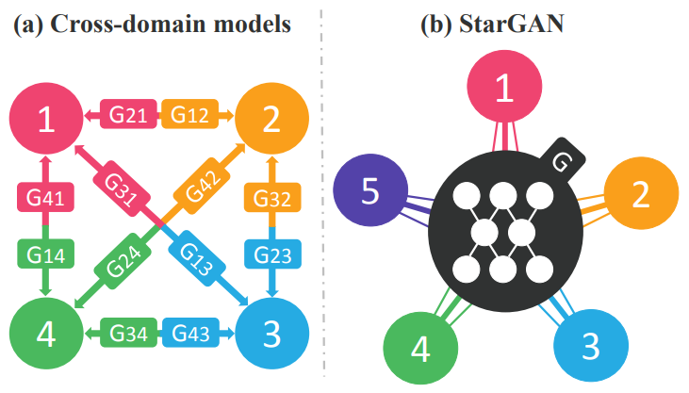
StarGAN: Unified Generative Adversarial Networks for Multi-Domain Image-to-Image Translation [Y. Choi et al., 2018] (2/7)
Introduction
Background
Required prior knowledge in image-to-image translation
Attribute: Meaningful feature inherent in an image ex) color, gender
Attribute value: Particular value of an attribute ex) black, female
Domain: A set of images sharing the same attribute value
Problems of previous cross-domain models
Separate network required for each domain in multi-domain image translation
Unable to fully utilize the existing global features from entire training data
Proposals
Discriminator
Applying domain classification
Enable to handle multi-domain task
Generator
Applying domain classification
Applying reconstruction
Enable to learn general features
Others
Applying mask vector
Enable to handle multi-domain task
Comparison between cross-domain models and StarGAN
Y. Choi et al., “StarGAN: Unified Generative Adversarial Networks for Multi-Domain
Image-to-Image Translation,” Computer Vision & Pattern Recognition, 2018.

Slide 4
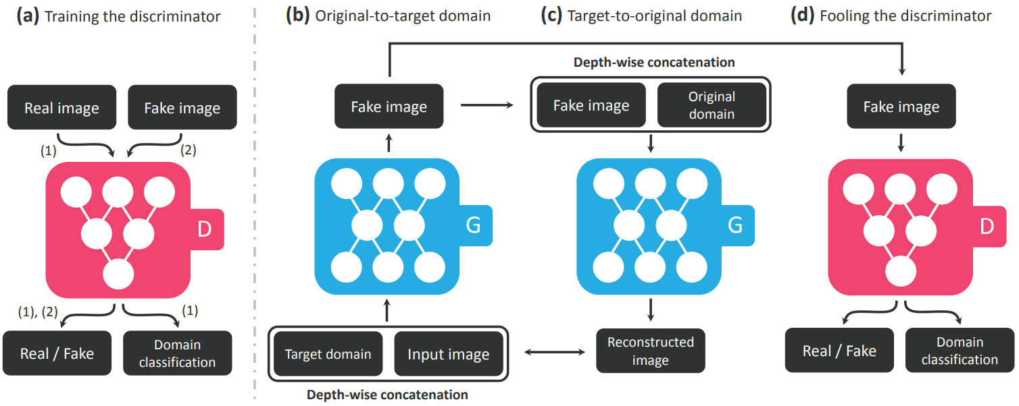
StarGAN: Unified Generative Adversarial Networks for Multi-Domain Image-to-Image Translation [Y. Choi et al., 2018] (3/7)
Architecture
Modules
Discriminator
Learning to distinguish between real and fake images
Classifying the real images to its corresponding domain
Generator
Taking in as input both the image and target domain and generates an fake image
Learning to reconstruct the original image from the fake and original domain
Learning the reconstructed image to be similar to the original image
Generating images indistinguishable from real images and classifiable
Overview of StarGAN architecture
Y. Choi et al., “StarGAN: Unified Generative Adversarial Networks for Multi-Domain
Image-to-Image Translation,” Computer Vision & Pattern Recognition, 2018.

Slide 5
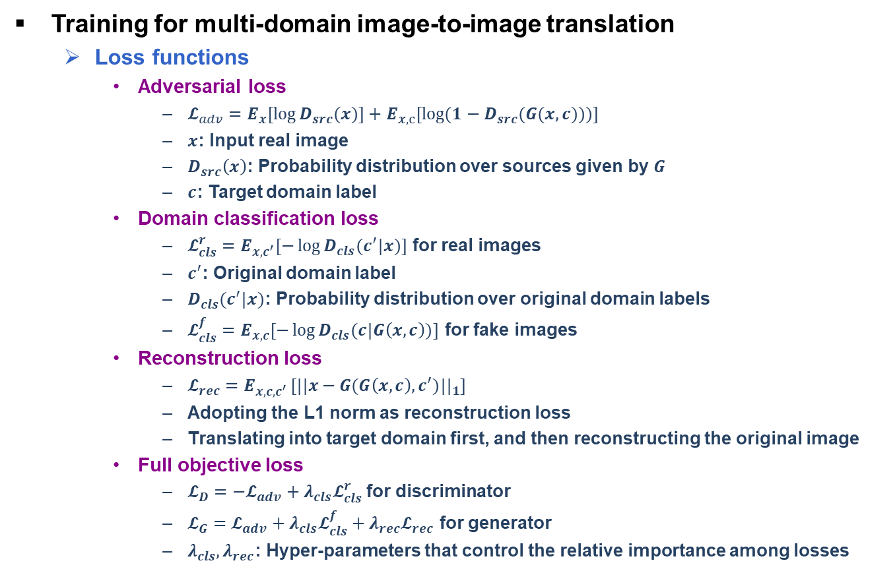
StarGAN: Unified Generative Adversarial Networks for Multi-Domain Image-to-Image Translation [Y. Choi et al., 2018] (4/7)
Training for multi-domain image-to-image translation
Loss functions
Adversarial loss
$𝓛_{adv}=E_{x}[\log{D_{src}(x)]+E_{x,c}[\log{(1−D_{src}(G(x,c)))]}}$
$x$: Input real image
$D_{src}\left(x\right)$: Probability distribution over sources given by $G$
$c$: Target domain label
Domain classification loss
$𝓛_{cls}^{r}=E_{x,c^{′}}[−\log{D_{cls}(c^{′}|x)]}$ for real images
$c^{′}$: Original domain label
$D_{cls}(c^{′}|x)$: Probability distribution over original domain labels
$𝓛_{cls}^{f}=E_{x,c}[−\log{D_{cls}(c|G\left(x,c\right))]}$ for fake images
Reconstruction loss
$𝓛_{rec}=E_{x,c,c^{′} }[{||x−G(G\left(x,c\right),c^{′})||}_{1}]$
Adopting the L1 norm as reconstruction loss
Translating into target domain first, and then reconstructing the original image
Full objective loss
$𝓛_{D}=−𝓛_{adv}+λ_{cls}𝓛_{cls}^{r}$for discriminator
$𝓛_{G}=𝓛_{adv}+λ_{cls}𝓛_{cls}^{f}+λ_{rec}𝓛_{rec}$ for generator
$λ_{cls}, λ_{rec}$: Hyper-parameters that control the relative importance among losses
Y. Choi et al., “StarGAN: Unified Generative Adversarial Networks for Multi-Domain
Image-to-Image Translation,” Computer Vision & Pattern Recognition, 2018.

Slide 6
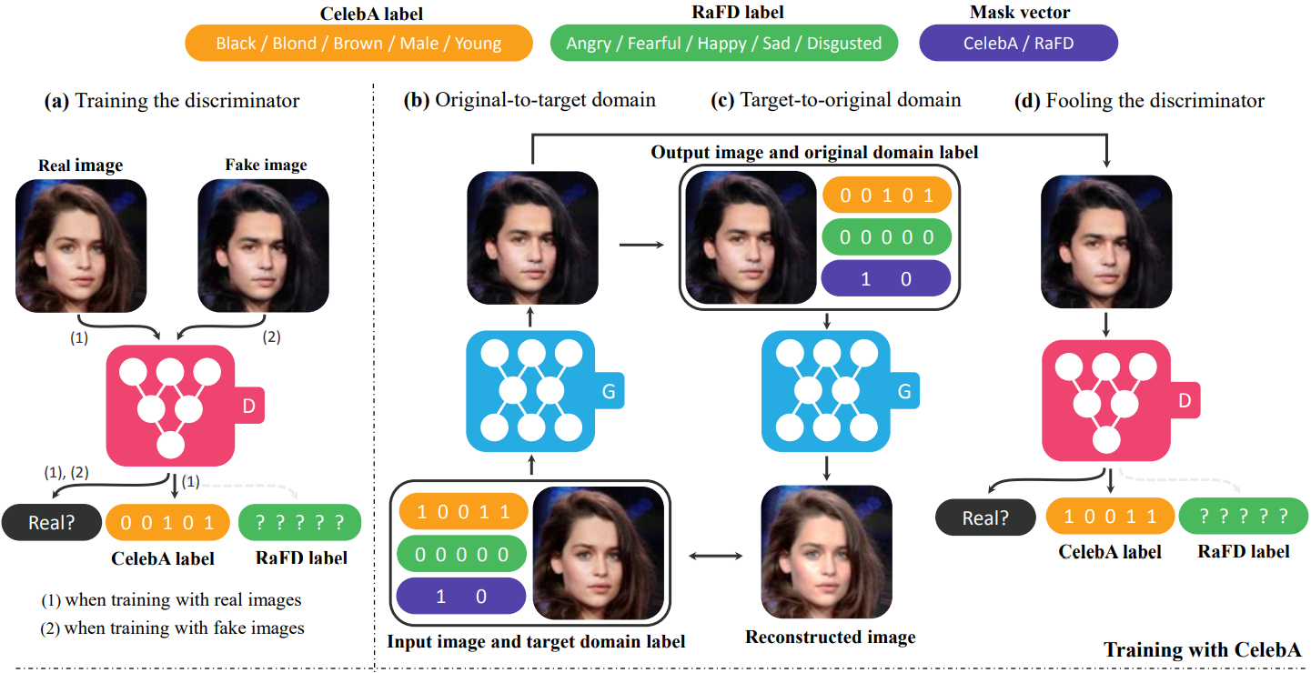
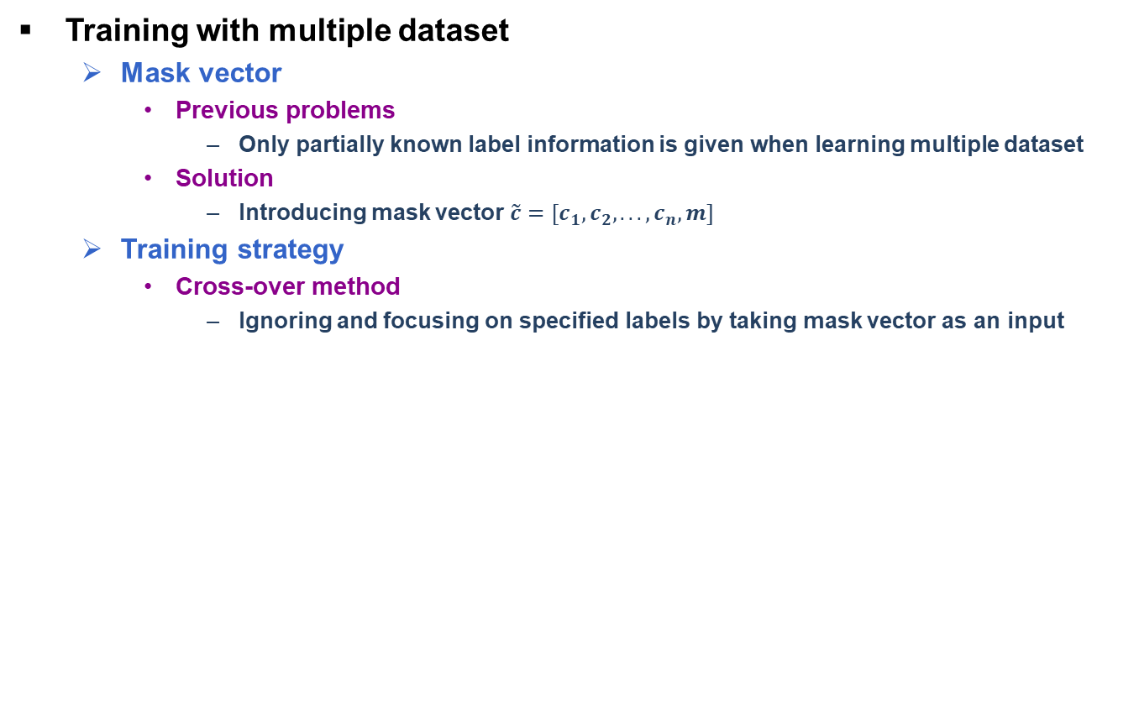
StarGAN: Unified Generative Adversarial Networks for Multi-Domain Image-to-Image Translation [Y. Choi et al., 2018] (5/7)
Training with multiple dataset
Mask vector
Previous problems
Only partially known label information is given when learning multiple dataset
Solution
Introducing mask vector $\tilde{c}=[c_{1},c_{2},..., c_{n},m]$
Training strategy
Cross-over method
Ignoring and focusing on specified labels by taking mask vector as an input
Overview of StarGAN training with both CelebA and RaFD
Y. Choi et al., “StarGAN: Unified Generative Adversarial Networks for Multi-Domain
Image-to-Image Translation,” Computer Vision & Pattern Recognition, 2018.

Slide 7
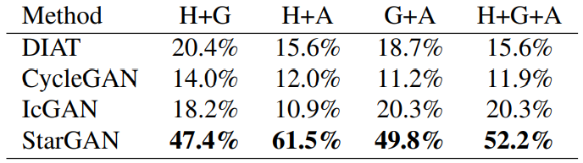
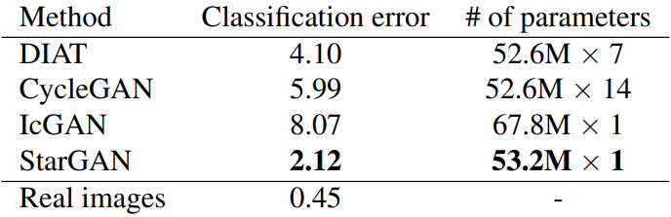
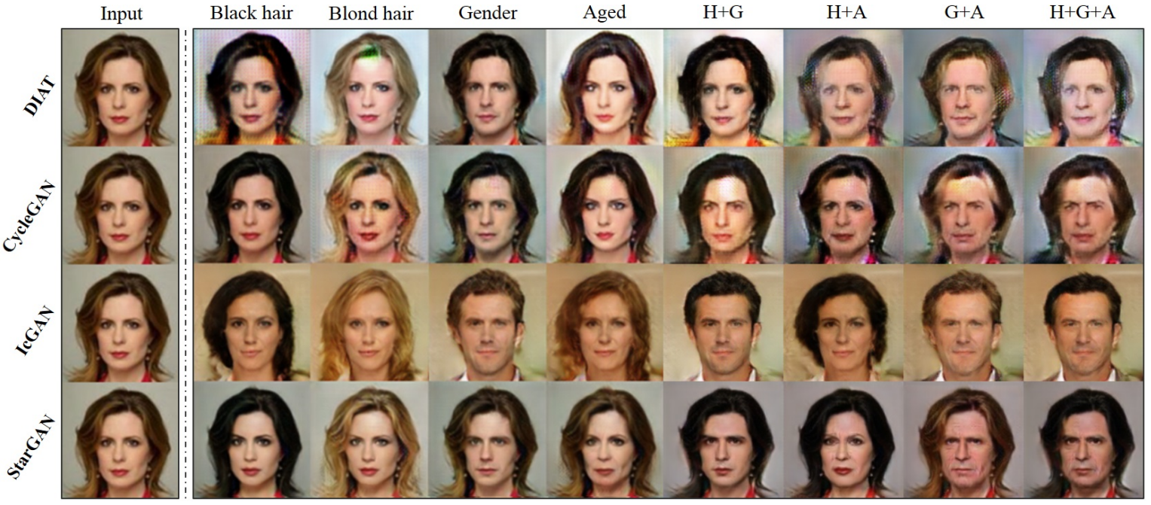
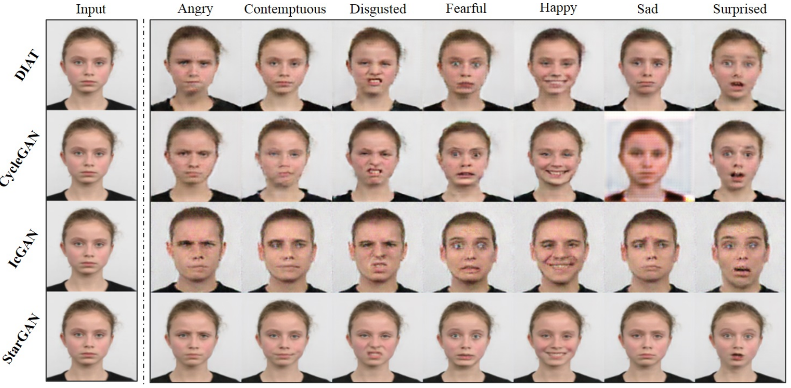
StarGAN: Unified Generative Adversarial Networks for Multi-Domain Image-to-Image Translation [Y. Choi et al., 2018] (6/7)
Experiments
Qualitative evaluation
Reasons for SOTA
Regularization effect through multi-domain
Learning reliable features universally
Maintaining spatial information using ConvNet
Quantitative evaluation
AMT perceptual evaluation
Achieving 1st ranking on both single and
multi-attribute transfer task
Efficiency
Having fewer parameters than others
AMT perceptual evaluation results
Classification errors and the number of parameters
Facial attribute transfer results on the CelebA dataset
Facial attribute transfer results on the CelebA dataset
Y. Choi et al., “StarGAN: Unified Generative Adversarial Networks for Multi-Domain
Image-to-Image Translation,” Computer Vision & Pattern Recognition, 2018.

Slide 8
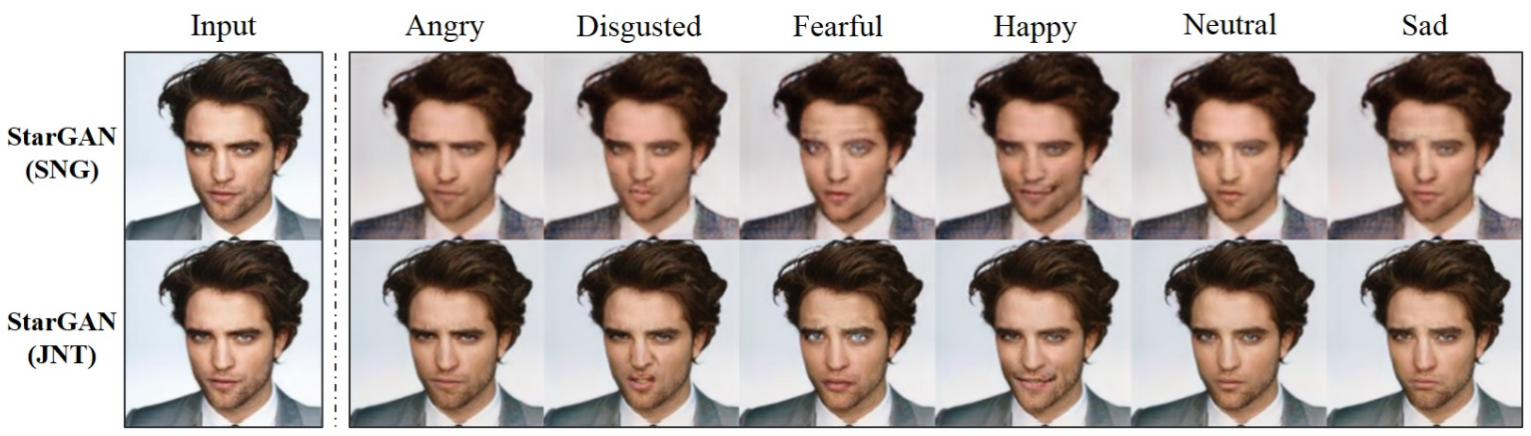
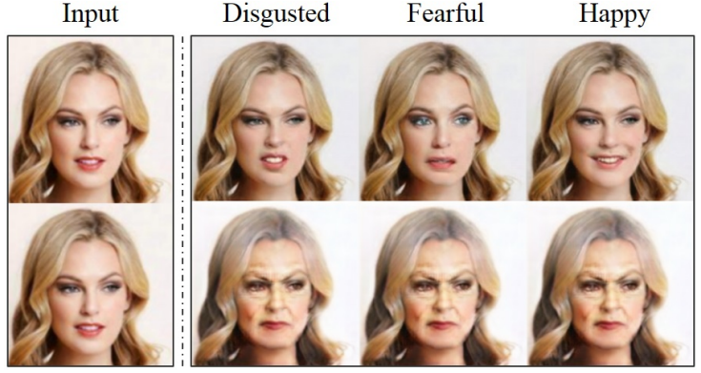
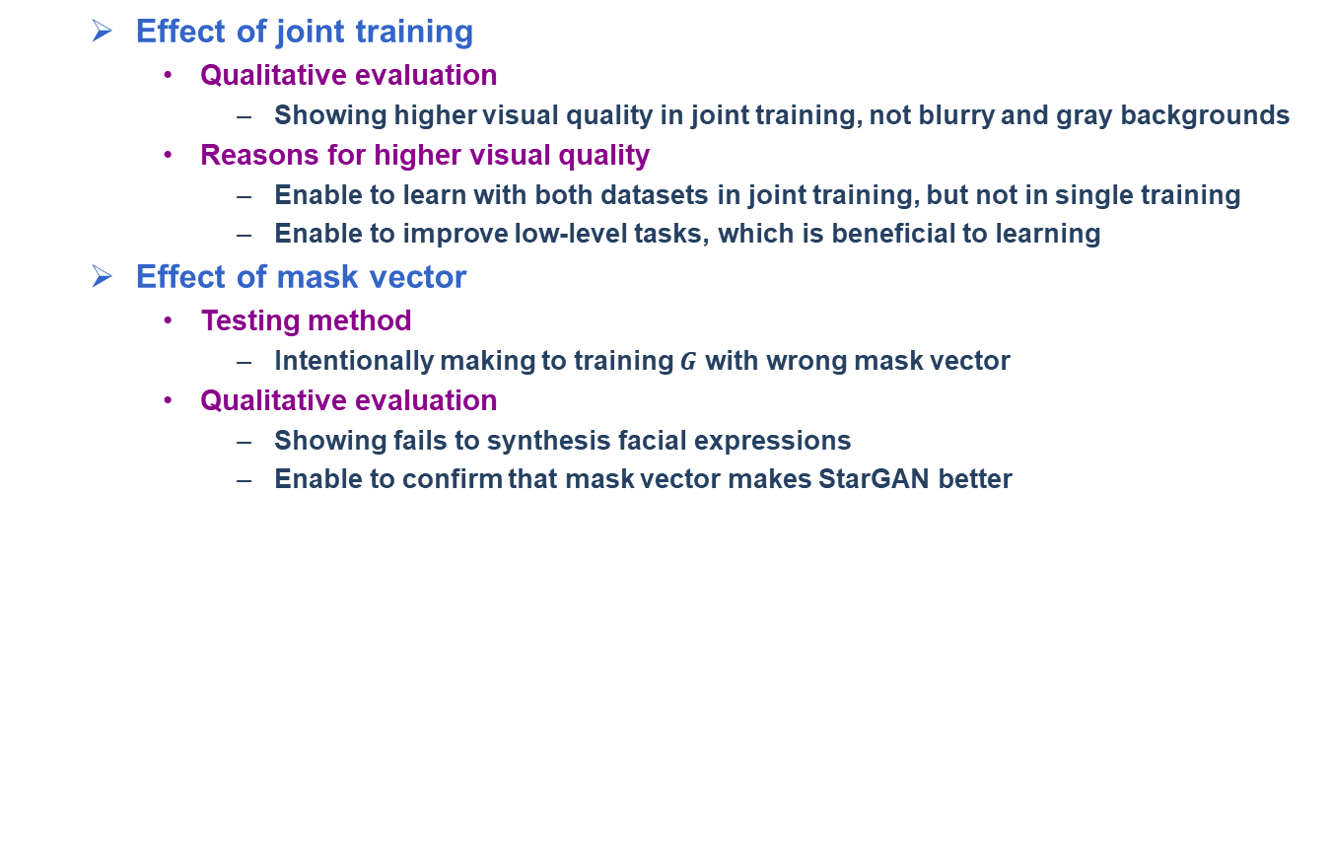
StarGAN: Unified Generative Adversarial Networks for Multi-Domain Image-to-Image Translation [Y. Choi et al., 2018] (7/7)
Effect of joint training
Qualitative evaluation
Showing higher visual quality in joint training, not blurry and gray backgrounds
Reasons for higher visual quality
Enable to learn with both datasets in joint training, but not in single training
Enable to improve low-level tasks, which is beneficial to learning
Effect of mask vector
Testing method
Intentionally making to training $G$ with wrong mask vector
Qualitative evaluation
Showing fails to synthesis facial expressions
Enable to confirm that mask vector makes StarGAN better
Facial expression synthesis results of single and joint dataset
Learned role of the mask vector
Y. Choi et al., “StarGAN: Unified Generative Adversarial Networks for Multi-Domain
Image-to-Image Translation,” Computer Vision & Pattern Recognition, 2018.

